Slide 1


PROJECT PHASE-2 PRESENTATION
CLOUD NATIVE STUDENT PERFORMACE PREDICTION
Submitted To :-
Dr. Shanu K. Rakesh
HOD CSE
Team Members :-
ANIRUDH TRIVEDI
(8TH SEM CSE|300202221069)
SHIVAM KUMAR YADAV
(8TH SEM CSE|300202221057)
TARUN KUMAR RATHORE
(8TH SEM CSE|300202221007)
NIKHIL KUMAR MAHANT
(8TH SEM CSE|300202221073)
Guided By :-
Dr. Shanu K. Rakesh
HOD CSE
Chouksey Engineering College, Bilaspur

Slide 2
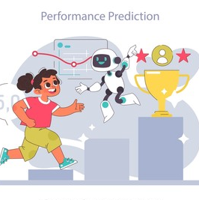
CONTENT
01
Background and Motivation
02
Problem Statement
03
Problem Objectives
04
Scope and Limitation
05
Data Collection and Processing
06
Model Implementation and evaluation
07
Containerization with Docker
08
Cloud Deployment in GCP
09
Summary of EDA Findings
10
Result and Model Comparision
11
Conclusion and Future Direction

Slide 3

Background and Motivation
Importance of Academic Performance
Need for Early Intervention
Student performance is a multifaceted topic influenced by various factors such as socioeconomic status, learning environment, and individual student characteristics. As education continues to evolve, understanding these dynamics through data can provide insights that are pivotal for improving educational outcomes.
Predicting student performance enables educators to identify at-risk students early and implement interventions. This proactive approach not only enhances individual learning experiences but also contributes to overall academic success within educational institutions.
Role of Machine Learning
Analyzes data to predict outcomes and improve educational strategies.

Slide 4


Problem Statement
Automated Prediction
Input Features
System predicts final student performance score from key factors.
Includes gender, section, parental education, lunch type, test prep, and marks.
Accessibility and Scalability
Deployment must be robust, scalable, and publicly accessible.

Slide 5
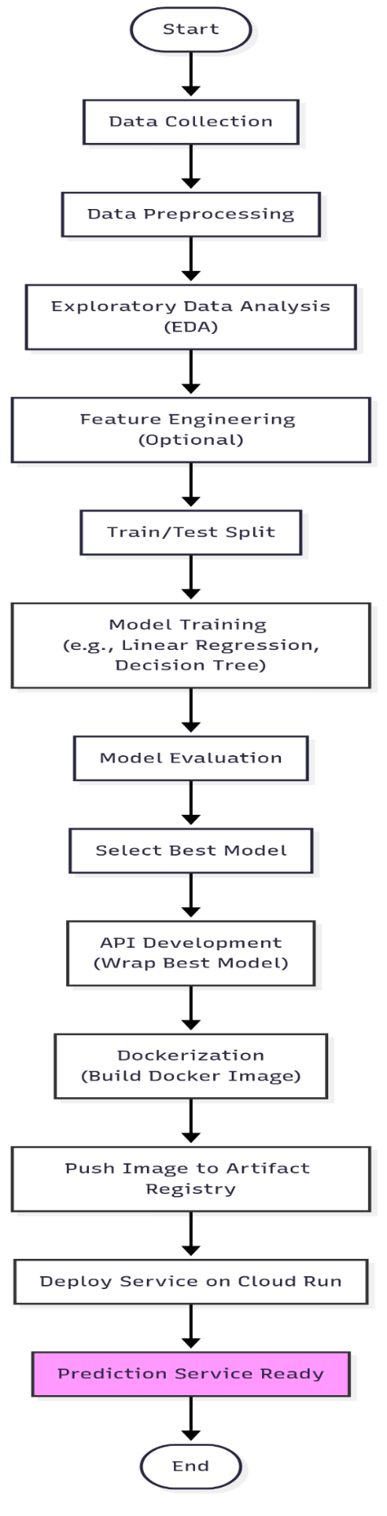
Project Objectives
Collect and preprocess student dataset.
Perform exploratory data analysis (EDA).
Train Linear Regression and Decision Tree models.
Evaluate models using MAE, MSE, RMSE, and R².
Containerize app with Docker.
Deploy on Google Cloud Platform.

Slide 6
Scope and Limitations
Scope
Limitations
Predict continuous performance score.
Depends on dataset quality and representativeness.
Use Python, Linear Regression, Decision Tree.
Excludes factors like motivation and attendance.
Deploy with Docker and GCP services.
No intervention strategies implemented.
Limited UI; focuses on prediction endpoint.
Ethical concerns briefly addressed.

Slide 7

Data Collection and Preprocessing
Feature Name | Description | Data Type | Example Values
gender | Student's gender | Categorical | 'Male', 'Female'
section | Class section or group | Categorical | 'A', 'B', 'C'
parental_education | Highest education level of parent(s) | Categorical | 'High School', 'Some College', 'Bachelor's Degree', 'Master's Degree', 'Associate's Degree'
lunch_type | Type of lunch program (proxy for SES) | Categorical | 'Standard', 'Free/Reduced'
test_preparation_course | Whether the student completed a prep course | Categorical | 'None', 'Completed'
theory_marks | Marks obtained in theory component (e.g., 0-100) | Numerical | 75, 88, 52
practical_marks | Marks obtained in practical component (e.g., 0-50) | Numerical | 40, 35, 48
Dataset Features
Preprocessing Steps
Includes demographics, socio-economic, and academic inputs.
Data cleaning, handling missing values, encoding categorical data.
Exploratory Data Analysis
Identified relationships and patterns among variables.

Slide 8
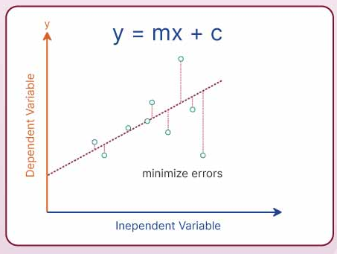
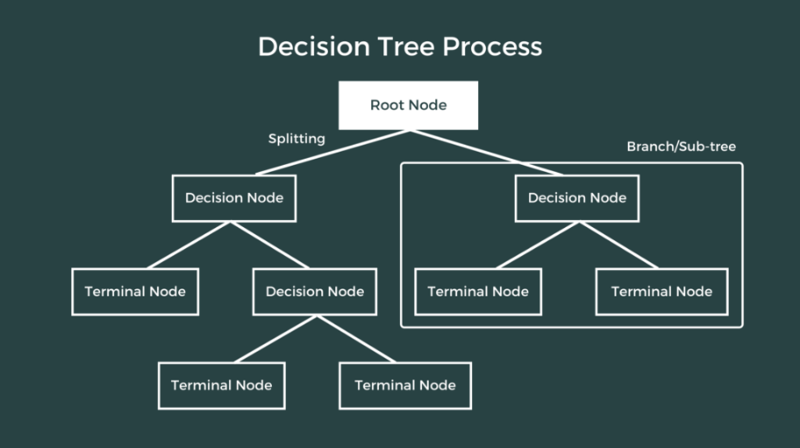
Model Implementation and Evaluation
Models Used
Evaluation Metrics
Linear Regression and Decision Tree Regressor.
Mean Absolute Error (MAE)
Mean Squared Error (MSE)
Root Mean Squared Error (RMSE)
R-squared (R²)

Slide 9
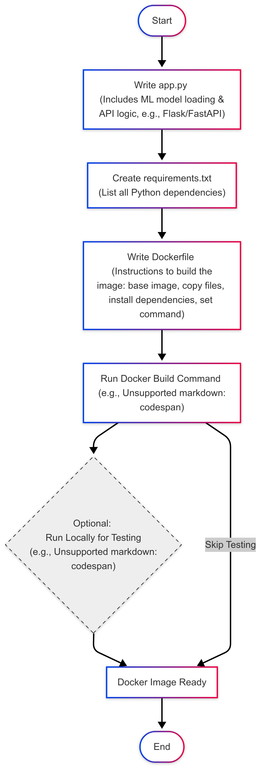

Containerization with Docker
Purpose
Contents
Ensure consistency and portability of the prediction app.
Includes trained model and prediction endpoint.
Benefits
Easy deployment and scalability across environments.

Slide 10
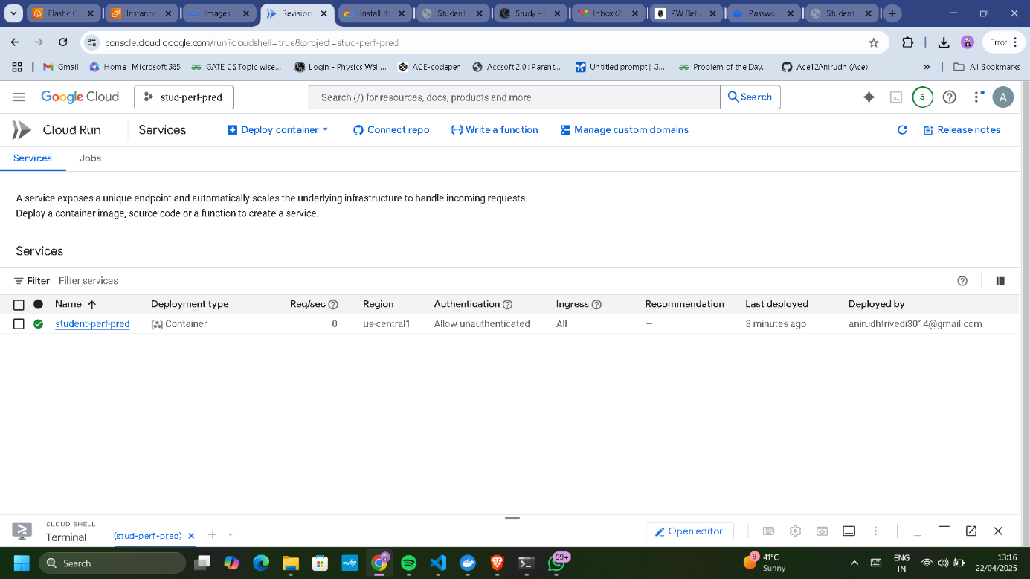
Cloud Deployment on Google Cloud Platform
Artifact Registry
Cloud Run
Accessibility
Stores Docker image securely.
Serves prediction service serverlessly and scalably.
Publicly accessible for educational stakeholders.

Slide 11
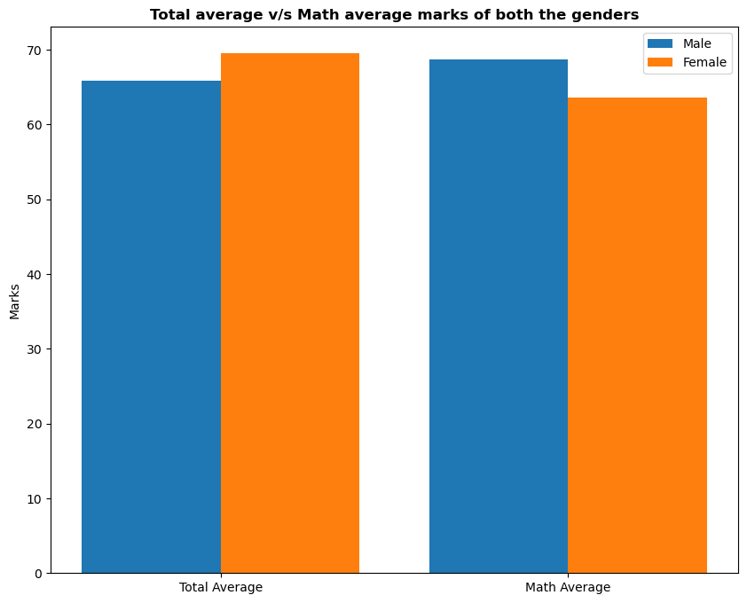
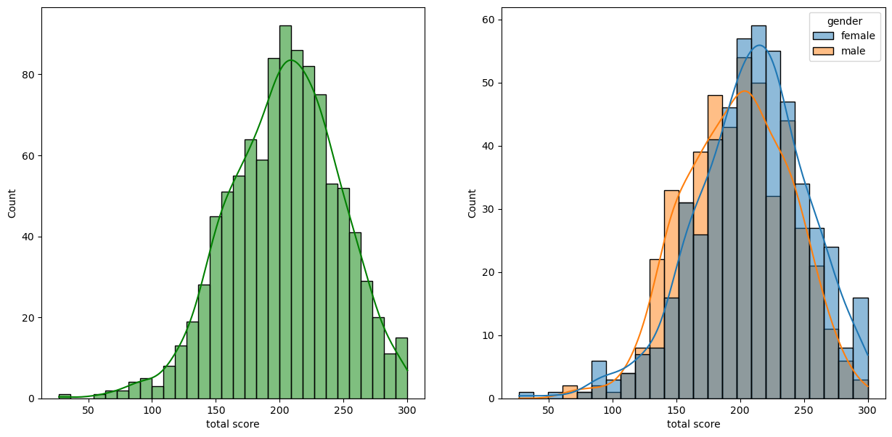
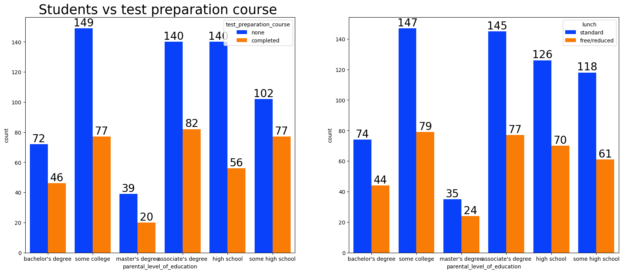
Summary of EDA Findings
Histogram of Total score
Bar Graph of total marks vs subject score
Count Plot of test preparation course and lunch

Slide 12
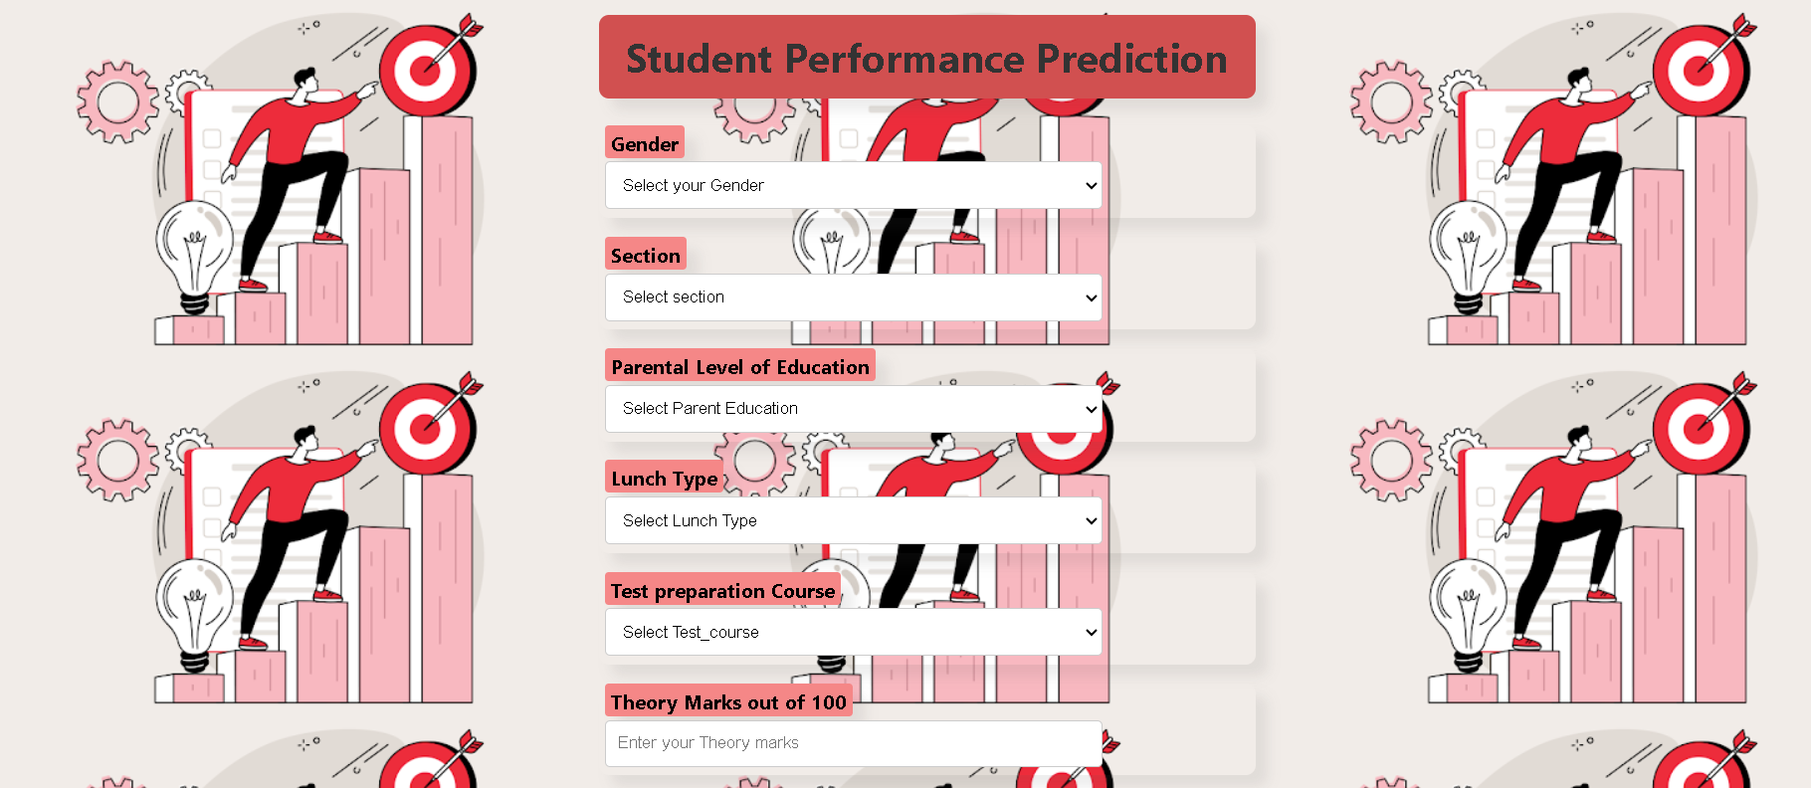
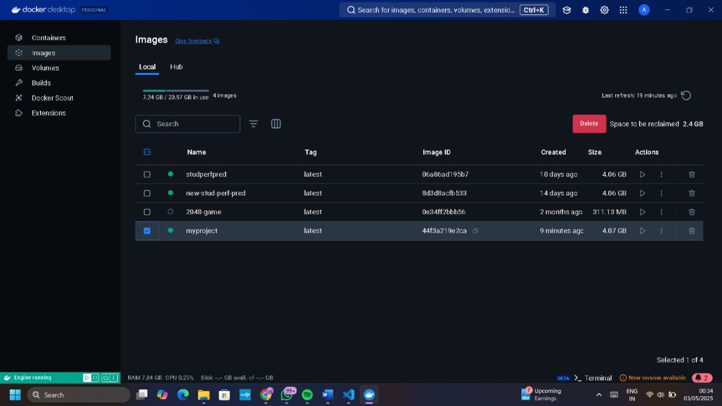
Result and Model Comparison
Metric | Linear Regression | Decision Tree Regressor | Better Model
Mean Absolute Error (MAE) | 4.21 | 6.02 | 4.2/6.02
Mean Squared Error (MSE) | 53.9 | 76.3 | 53.9/76.3
Root Mean Squared Error (RMSE) | 5.3 | 7.6 | 5.3/7.6
R-squared (R²) | 0.88 | 0.76 | 0.88/0.76
This project successfully developed and deployed a machine learning system
for predicting student academic performance
This provides a scalable, highly available, and publicly accessible HTTPS
endpoint for making predictions, demonstrating a practical application of
machine learning in an educational context using modern cloud infrastructure.

Slide 13

Conclusion and Future Directions
Key Achievements
Potential Enhancements
Developed and deployed ML models predicting student performance.
Include more factors and build intervention strategies.
Next Steps
Expand dataset, improve accuracy, and enhance user interface.

Slide 14
THANK YOU ! …..

